Slide 1


Lesson 6
Project

Slide 2
Learning Objectives
By the end of this lesson, you will…
Understand how a sequence of code works
Understand what a function is
Understand what a function with an argument is
Understand how to create and update variables
Understand how to create loops with definite ranges
Understand how to capture user input
Understand how to endure the right data types are use
Understand how to reuse code

Slide 3
Lesson 6
Creating a project
In this lesson, we shall use all of our knowledge to create a custom pattern generator using EduBlocks and Turtle
Can you remember all of the coding concepts that we learnt?

Slide 4
Lesson 6
Coding Concepts
Over the past five lessons we have learnt:
How to write a sequence
How to use loops
How to capture user input
How to work with data types
How to store data in a variable
How to make decisions using conditional statements
How to use functions to reuse code

Slide 5
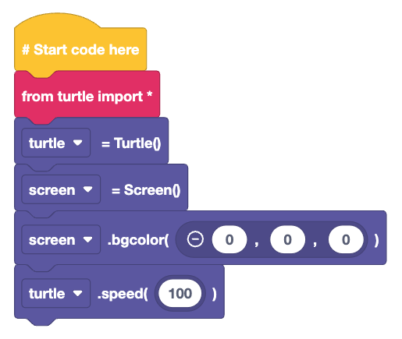
Lesson 6
Starting the project
Before we start the project we need to:
Import the turtle module
Connect to Turtle
Create a screen
Set the screen colour to Black
Speed up the Turtle to 100!

Slide 6
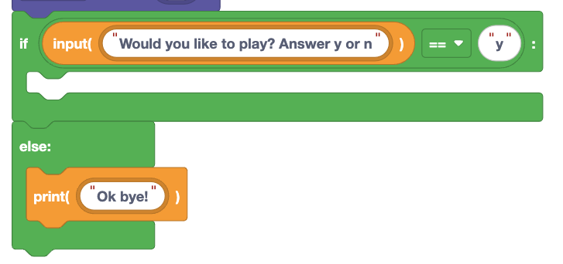
Lesson 6
Starting the game
Would you like to play a game?
This is the question asked to the user before the sequence starts
If they answer “y” the code will run
But if they answer “n” or anything else, the else condition is activated and the game ends

Slide 7
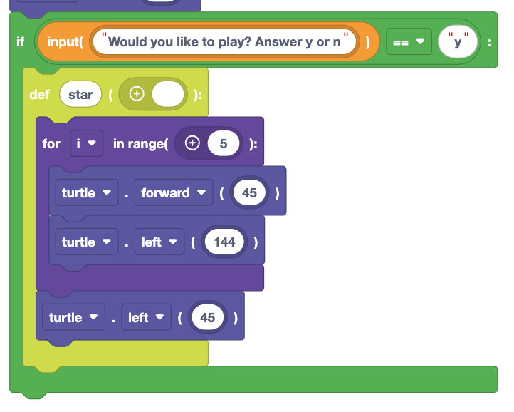
Lesson 6
What happens if…?
If the player chooses to play, then any code inside the if condition is activated.
Inside the if condition we create a function to draw a star pattern.

Slide 8
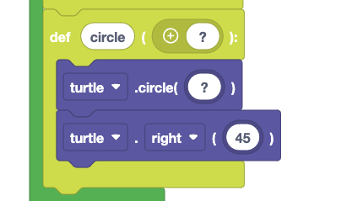
Lesson 6
Draw a circle
Here we create a function to draw a circle
But, what do we replace “?” with?
Is it the diameter of the circle?
The radius?
Or the circumference?

Slide 9
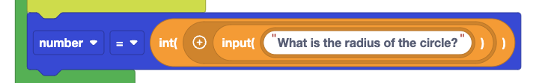
Lesson 6
What is the radius of a circle?
To set the radius of the circle…
We need to ask the user, via user input
Then ensure the value given is an integer
Save the answer to a variable called “number”
Why do we want the value to be an integer?

Slide 10
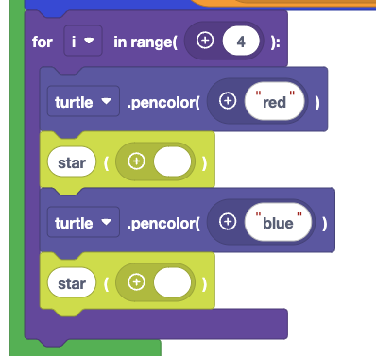
Lesson 6
Draw 4 stars
Using a loop is a smart move
We can write code once, and run it many times
Here we set the Turtle pen colour to “red” and then “blue, in between we call the star function

Slide 11
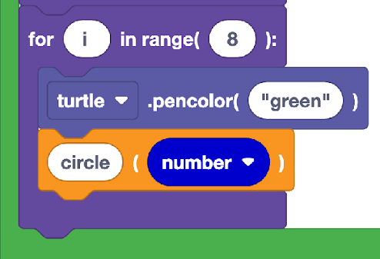
Lesson 6
8 Circles
To draw 8 circles we use another for loop
We set the pen colour to green, and then call the circle function, using the data saved in the number variable

Slide 12
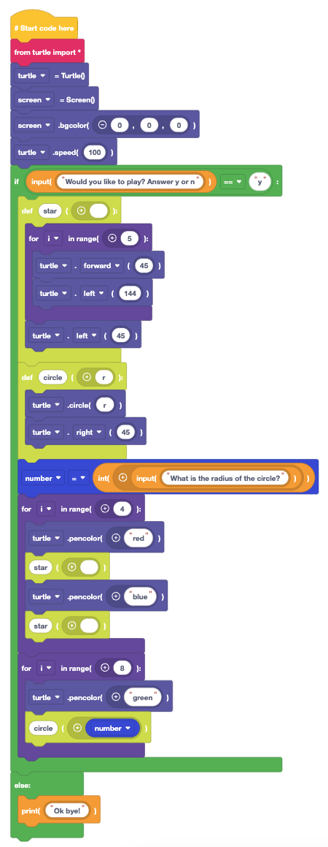
Lesson 6
Complete Code Listing
Here is all of the code in EduBlocks.
Your teacher will now open the code and can zoom in for clarity.
Can you alter the code to
Draw another shape?
Ask the user how many circles to draw?
Put all of the code in a while True loop
Can you also add new features?

Slide 13
Plenary
What have we learnt?
How to create a full project using code from previous lessons
That code can be used for creative projects
That Sequence, Selection, Iteration, Assignment and Loops are key coding concepts

Slide 14

Plenary
Congratulations!
You have successfully completed six lessons with EduBlocks, learn how to write Python code with blocks and be creative!
Next lesson, we’ll test our knowledge with an end of unit assessment

